Slide 1
Data Mining:
Concepts and Techniques
— Chapter 2 —
Jiawei Han
Department of Computer Science
University of Illinois at Urbana-Champaign
www.cs.uiuc.edu/~hanj
©2006 Jiawei Han and Micheline Kamber, All rights reserved
Data Mining: Concepts and Techniques

Slide 2
Chapter 2: Data Preprocessing
Why preprocess the data?
Descriptive data summarization
Data cleaning
Data integration and transformation
Data reduction
Discretization and concept hierarchy generation
Summary
Data Mining: Concepts and Techniques

Slide 3
Why Data Preprocessing?
Data in the real world is dirty
  incomplete: lacking attribute values, lacking certain attributes of interest, or containing only aggregate data
    e.g., occupation=“ ”
  noisy: containing errors or outliers
    e.g., Salary=“-10”
  inconsistent: containing discrepancies in codes or names
    e.g., Age=“42” Birthday=“03/07/1997”
    e.g., Was rating “1,2,3”, now rating “A, B, C”
    e.g., discrepancy between duplicate records
Data Mining: Concepts and Techniques

Slide 4
Why Is Data Dirty?
Incomplete data may come from
  “Not applicable” data value when collected
  Different considerations between the time when the data was collected and when it is analyzed.
  Human/hardware/software problems
Noisy data (incorrect values) may come from
  Faulty data collection instruments
  Human or computer error at data entry
  Errors in data transmission
Inconsistent data may come from
  Different data sources
  Functional dependency violation (e.g., modify some linked data)
Duplicate records also need data cleaning
Data Mining: Concepts and Techniques

Slide 5
Why Is Data Preprocessing Important?
No quality data, no quality mining results!
  Quality decisions must be based on quality data
    e.g., duplicate or missing data may cause incorrect or even misleading statistics.
  Data warehouse needs consistent integration of quality data
Data extraction, cleaning, and transformation comprises the majority of the work of building a data warehouse
Data Mining: Concepts and Techniques

Slide 6
Multi-Dimensional Measure of Data Quality
A well-accepted multidimensional view:
  Accuracy
  Completeness
  Consistency
  Timeliness
  Believability
  Value added
  Interpretability
  Accessibility
Broad categories:
  Intrinsic, contextual, representational, and accessibility
Data Mining: Concepts and Techniques

Slide 7
Major Tasks in Data Preprocessing
Data cleaning
  Fill in missing values, smooth noisy data, identify or remove outliers, and resolve inconsistencies
Data integration
  Integration of multiple databases, data cubes, or files
Data transformation
  Normalization and aggregation
Data reduction
  Obtains reduced representation in volume but produces the same or similar analytical results
Data discretization
  Part of data reduction but with particular importance, especially for numerical data
Data Mining: Concepts and Techniques

Slide 8

Forms of Data Preprocessing
Data Mining: Concepts and Techniques

Slide 9
Chapter 2: Data Preprocessing
Why preprocess the data?
Descriptive data summarization
Data cleaning
Data integration and transformation
Data reduction
Discretization and concept hierarchy generation
Summary
Data Mining: Concepts and Techniques

Slide 10
Mining Data Descriptive Characteristics
Motivation
  To better understand the data: central tendency, variation and spread
Data dispersion characteristics
  median, max, min, quantiles, outliers, variance, etc.
Numerical dimensions correspond to sorted intervals
  Data dispersion: analyzed with multiple granularities of precision
  Boxplot or quantile analysis on sorted intervals
Dispersion analysis on computed measures
  Folding measures into numerical dimensions
  Boxplot or quantile analysis on the transformed cube
Data Mining: Concepts and Techniques

Slide 11
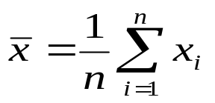

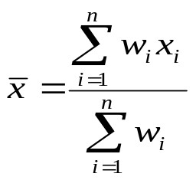
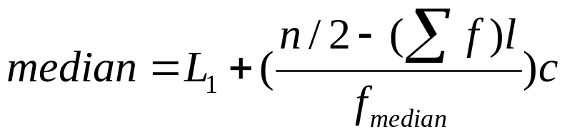
Measuring the Central Tendency
Mean (algebraic measure) (sample vs. population):
  Weighted arithmetic mean:
  Trimmed mean: chopping extreme values
Median: A holistic measure
  Middle value if odd number of values, or average of the middle two values otherwise
  Estimated by interpolation (for grouped data):
Mode
  Value that occurs most frequently in the data
  Unimodal, bimodal, trimodal
  Empirical formula:
Data Mining: Concepts and Techniques

Slide 12



Symmetric vs. Skewed Data
Median, mean and mode of symmetric, positively and negatively skewed data
Data Mining: Concepts and Techniques

Slide 13


Measuring the Dispersion of Data
Quartiles, outliers and boxplots
  Quartiles: Q₁ (25th percentile), Q₃ (75th percentile)
  Inter-quartile range: IQR = Q₃ – Q₁
  Five number summary: min, Q₁, M, Q₃, max
  Boxplot: ends of the box are the quartiles, median is marked, whiskers, and plot outlier individually
  Outlier: usually, a value higher/lower than 1.5 x IQR
Variance and standard deviation (sample: s, population: σ)
  Variance: (algebraic, scalable computation)
  Standard deviation s (or σ) is the square root of variance s² ⁽or σ²⁾
Data Mining: Concepts and Techniques

Slide 14
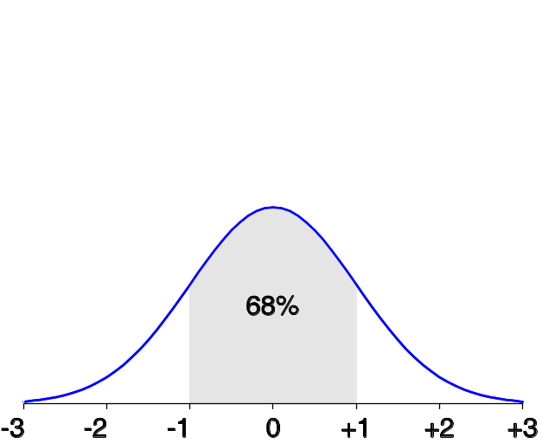
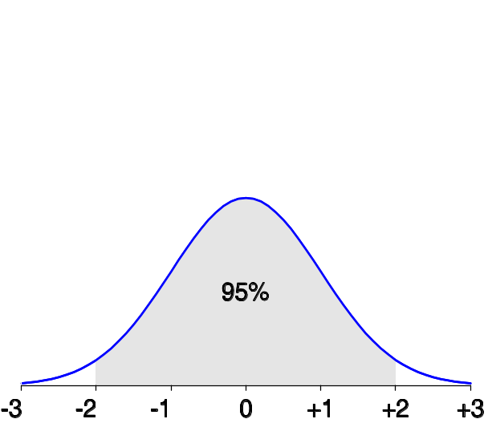
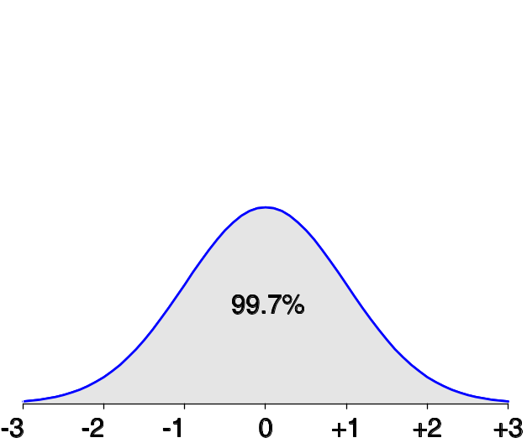
Properties of Normal Distribution Curve
The normal (distribution) curve
  From μ–σ to μ+σ: contains about 68% of the measurements (μ: mean, σ: standard deviation)
  From μ–2σ to μ+2σ: contains about 95% of it
  From μ–3σ to μ+3σ: contains about 99.7% of it
Data Mining: Concepts and Techniques

Slide 15

Boxplot Analysis
Five-number summary of a distribution:
  Minimum, Q1, M, Q3, Maximum
Boxplot
  Data is represented with a box
  The ends of the box are at the first and third quartiles, i.e., the height of the box is IQR
  The median is marked by a line within the box
  Whiskers: two lines outside the box extend to Minimum and Maximum
Data Mining: Concepts and Techniques

Slide 16

Visualization of Data Dispersion: Boxplot Analysis
Data Mining: Concepts and Techniques

Slide 17

Histogram Analysis
Graph displays of basic statistical class descriptions
  Frequency histograms
    A univariate graphical method
    Consists of a set of rectangles that reflect the counts or frequencies of the classes present in the given data
Data Mining: Concepts and Techniques

Slide 18
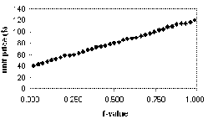
Quantile Plot
Displays all of the data (allowing the user to assess both the overall behavior and unusual occurrences)
Plots quantile information
  For a data x_{i} data sorted in increasing order, f_{i} indicates that approximately 100 f_{i}% of the data are below or equal to the value x_{i}
Data Mining: Concepts and Techniques

Slide 19
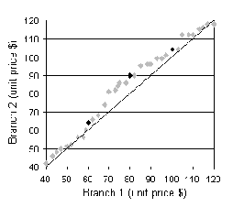
Quantile-Quantile (Q-Q) Plot
Graphs the quantiles of one univariate distribution against the corresponding quantiles of another
Allows the user to view whether there is a shift in going from one distribution to another
Data Mining: Concepts and Techniques

Slide 20
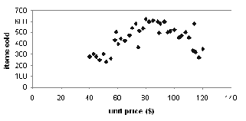
Scatter plot
Provides a first look at bivariate data to see clusters of points, outliers, etc
Each pair of values is treated as a pair of coordinates and plotted as points in the plane
Data Mining: Concepts and Techniques

Slide 21
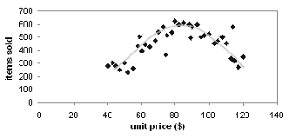
Loess Curve
Adds a smooth curve to a scatter plot in order to provide better perception of the pattern of dependence
Loess curve is fitted by setting two parameters: a smoothing parameter, and the degree of the polynomials that are fitted by the regression
Data Mining: Concepts and Techniques

Slide 22


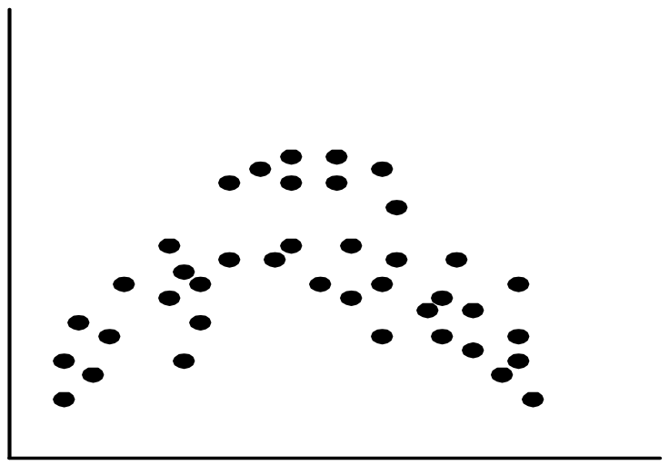
Positively and Negatively Correlated Data
Data Mining: Concepts and Techniques

Slide 23


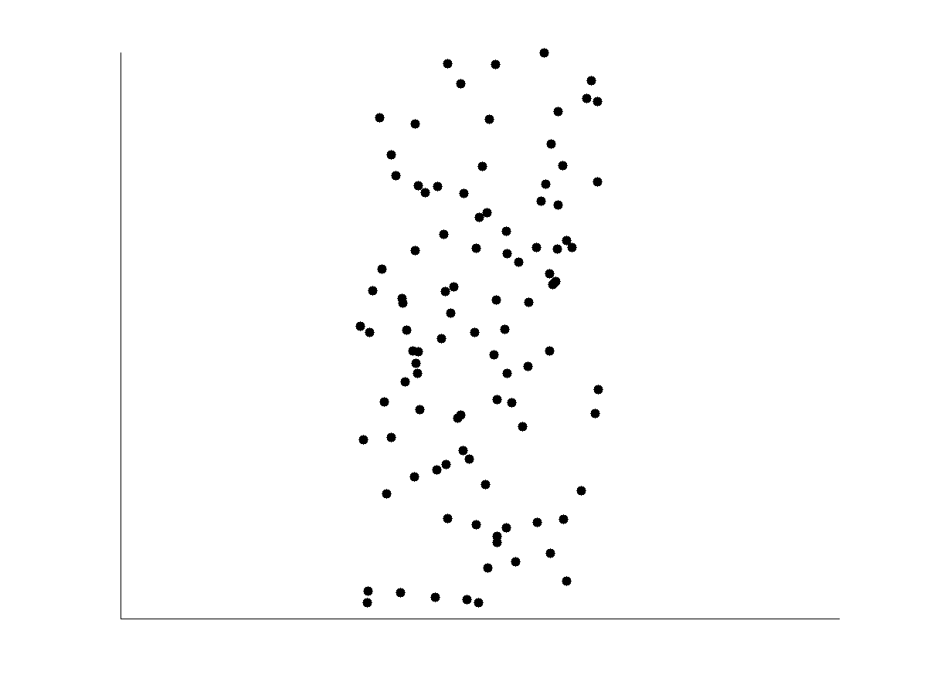
Not Correlated Data
Data Mining: Concepts and Techniques

Slide 24
Graphic Displays of Basic Statistical Descriptions
Histogram: (shown before)
Boxplot: (covered before)
Quantile plot: each value x_{i} is paired with f_{i} indicating that approximately 100 f_{i} % of data are ≤ x_{i}
Quantile-quantile (q-q) plot: graphs the quantiles of one univariant distribution against the corresponding quantiles of another
Scatter plot: each pair of values is a pair of coordinates and plotted as points in the plane
Loess (local regression) curve: add a smooth curve to a scatter plot to provide better perception of the pattern of dependence
Data Mining: Concepts and Techniques

Slide 25
Chapter 2: Data Preprocessing
Why preprocess the data?
Descriptive data summarization
Data cleaning
Data integration and transformation
Data reduction
Discretization and concept hierarchy generation
Summary
Data Mining: Concepts and Techniques

Slide 26
Data Cleaning
Importance
  “Data cleaning is one of the three biggest problems in data warehousing”—Ralph Kimball
  “Data cleaning is the number one problem in data warehousing”—DCI survey
Data cleaning tasks
  Fill in missing values
  Identify outliers and smooth out noisy data
  Correct inconsistent data
  Resolve redundancy caused by data integration
Data Mining: Concepts and Techniques

Slide 27
Missing Data
Data is not always available
  E.g., many tuples have no recorded value for several attributes, such as customer income in sales data
Missing data may be due to
  equipment malfunction
  inconsistent with other recorded data and thus deleted
  data not entered due to misunderstanding
  certain data may not be considered important at the time of entry
  not register history or changes of the data
Missing data may need to be inferred.
Data Mining: Concepts and Techniques

Slide 28
How to Handle Missing Data?
Ignore the tuple: usually done when class label is missing (assuming the tasks in classification—not effective when the percentage of missing values per attribute varies considerably.
Fill in the missing value manually: tedious + infeasible?
Fill in it automatically with
  a global constant : e.g., “unknown”, a new class?!
  the attribute mean
  the attribute mean for all samples belonging to the same class: smarter
  the most probable value: inference-based such as Bayesian formula or decision tree
Data Mining: Concepts and Techniques

Slide 29
Noisy Data
Noise: random error or variance in a measured variable
Incorrect attribute values may due to
  faulty data collection instruments
  data entry problems
  data transmission problems
  technology limitation
  inconsistency in naming convention
Other data problems which requires data cleaning
  duplicate records
  incomplete data
  inconsistent data
Data Mining: Concepts and Techniques

Slide 30
How to Handle Noisy Data?
Binning
  first sort data and partition into (equal-frequency) bins
  then one can smooth by bin means, smooth by bin median, smooth by bin boundaries, etc.
Regression
  smooth by fitting the data into regression functions
Clustering
  detect and remove outliers
Combined computer and human inspection
  detect suspicious values and check by human (e.g., deal with possible outliers)
Data Mining: Concepts and Techniques

Slide 31
Simple Discretization Methods: Binning
Equal-width (distance) partitioning
  Divides the range into N intervals of equal size: uniform grid
  if A and B are the lowest and highest values of the attribute, the width of intervals will be: W = (B –A)/N.
  The most straightforward, but outliers may dominate presentation
  Skewed data is not handled well
Equal-depth (frequency) partitioning
  Divides the range into N intervals, each containing approximately same number of samples
  Good data scaling
  Managing categorical attributes can be tricky
Data Mining: Concepts and Techniques

Slide 32
Binning Methods for Data Smoothing
Sorted data for price (in dollars): 4, 8, 9, 15, 21, 21, 24, 25, 26, 28, 29, 34
* Partition into equal-frequency (equi-depth) bins:
- Bin 1: 4, 8, 9, 15
- Bin 2: 21, 21, 24, 25
- Bin 3: 26, 28, 29, 34
* Smoothing by bin means:
- Bin 1: 9, 9, 9, 9
- Bin 2: 23, 23, 23, 23
- Bin 3: 29, 29, 29, 29
* Smoothing by bin boundaries:
- Bin 1: 4, 4, 4, 15
- Bin 2: 21, 21, 25, 25
- Bin 3: 26, 26, 26, 34
Data Mining: Concepts and Techniques

Slide 33
Regression
y
Y1
Y1’
y = x + 1
X1
x
Data Mining: Concepts and Techniques

Slide 34
Cluster Analysis
Data Mining: Concepts and Techniques

Slide 35
Data Cleaning as a Process
Data discrepancy detection
  Use metadata (e.g., domain, range, dependency, distribution)
  Check field overloading
  Check uniqueness rule, consecutive rule and null rule
  Use commercial tools
    Data scrubbing: use simple domain knowledge (e.g., postal code, spell-check) to detect errors and make corrections
    Data auditing: by analyzing data to discover rules and relationship to detect violators (e.g., correlation and clustering to find outliers)
Data migration and integration
  Data migration tools: allow transformations to be specified
  ETL (Extraction/Transformation/Loading) tools: allow users to specify transformations through a graphical user interface
Integration of the two processes
  Iterative and interactive (e.g., Potter’s Wheels)
Data Mining: Concepts and Techniques

Slide 36
Chapter 2: Data Preprocessing
Why preprocess the data?
Data cleaning
Data integration and transformation
Data reduction
Discretization and concept hierarchy generation
Summary
Data Mining: Concepts and Techniques

Slide 37
Data Integration
Data integration:
  Combines data from multiple sources into a coherent store
Schema integration: e.g., A.cust-id ≡ B.cust-#
  Integrate metadata from different sources
Entity identification problem:
  Identify real world entities from multiple data sources, e.g., Bill Clinton = William Clinton
Detecting and resolving data value conflicts
  For the same real world entity, attribute values from different sources are different
  Possible reasons: different representations, different scales, e.g., metric vs. British units
Data Mining: Concepts and Techniques

Slide 38
Handling Redundancy in Data Integration
Redundant data occur often when integration of multiple databases
  Object identification: The same attribute or object may have different names in different databases
  Derivable data: One attribute may be a “derived” attribute in another table, e.g., annual revenue
Redundant attributes may be able to be detected by correlation analysis
Careful integration of the data from multiple sources may help reduce/avoid redundancies and inconsistencies and improve mining speed and quality
Data Mining: Concepts and Techniques

Slide 39
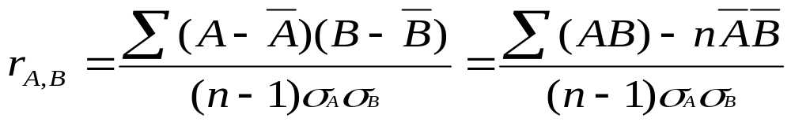


Correlation Analysis (Numerical Data)
Correlation coefficient (also called Pearson’s product moment coefficient)
  where n is the number of tuples, and are the respective means of A and B, σ_{A} and σ_{B} are the respective standard deviation of A and B, and Σ(AB) is the sum of the AB cross-product.
If r_{A,B} > 0, A and B are positively correlated (A’s values increase as B’s). The higher, the stronger correlation.
r_{A,B} = 0: independent; r_{A,B} < 0: negatively correlated
Data Mining: Concepts and Techniques

Slide 40

Correlation Analysis (Categorical Data)
Χ² (chi-square) test
The larger the Χ² value, the more likely the variables are related
The cells that contribute the most to the Χ² value are those whose actual count is very different from the expected count
Correlation does not imply causality
  # of hospitals and # of car-theft in a city are correlated
  Both are causally linked to the third variable: population
Data Mining: Concepts and Techniques

Slide 41
Chi-Square Calculation: An Example
Χ² (chi-square) calculation (numbers in parenthesis are expected counts calculated based on the data distribution in the two categories)
It shows that like_science_fiction and play_chess are correlated in the group
 | Play chess | Not play chess | Sum (row)
Like science fiction | 250(90) | 200(360) | 450
Not like science fiction | 50(210) | 1000(840) | 1050
Sum(col.) | 300 | 1200 | 1500
Data Mining: Concepts and Techniques

Slide 42
Data Transformation
Smoothing: remove noise from data
Aggregation: summarization, data cube construction
Generalization: concept hierarchy climbing
Normalization: scaled to fall within a small, specified range
  min-max normalization
  z-score normalization
  normalization by decimal scaling
Attribute/feature construction
  New attributes constructed from the given ones
Data Mining: Concepts and Techniques

Slide 43
Data Normalization
The range of attributes (features) values differ, thus one feature might overpower the other one.
Solution: Normalization
  Scaling data values in a range such as [0 … 1], [-1 … 1] prevents outweighing features with large range like ‘salary’ over features with smaller range like ‘age’.
Data Mining: Concepts and Techniques

Slide 44





Data Transformation: Normalization
Min-max normalization: to [new_min_{A}, new_max_{A}]
  Ex. Let income range $12,000 to $98,000 normalized to [0.0, 1.0]. Then $73,000 is mapped to
Z-score normalization (μ: mean, σ: standard deviation):
  Ex. Let μ = 54,000, σ = 16,000. Then
Normalization by decimal scaling
Where j is the smallest integer such that Max(|ν’|) < 1
Data Mining: Concepts and Techniques

Slide 45
Z-Score (Example)
v | v’ |  |  | v | v’
0.18 | -0.84 | Avg | 0.68 | 20 | -.26 | Avg | 34.3
0.60 | -0.14 | sdev | 0.59 | 40 | .11 | sdev | 55.9
0.52 | -0.27 |  |  | 5 | .55
0.25 | -0.72 |  |  | 70 | 4
0.80 | 0.20 |  |  | 32 | -.05
0.55 | -0.22 |  |  | 8 | -.48
0.92 | 0.40 |  |  | 5 | -.53
0.21 | -0.79 |  |  | 15 | -.35
0.64 | -0.07 |  |  | 250 | 3.87
0.20 | -0.80 |  |  | 32 | -.05
0.63 | -0.09 |  |  | 18 | -.30
0.70 | 0.04 |  |  | 10 | -.44
0.67 | -0.02 |  |  | -14 | -.87
0.58 | -0.17 |  |  | 22 | -.23
0.98 | 0.50 |  |  | 45 | .20
0.81 | 0.22 |  |  | 60 | .47
0.10 | -0.97 |  |  | -5 | -.71
0.82 | 0.24 |  |  | 7 | -.49
0.50 | -0.30 |  |  | 2 | -.58
3.00 | 3.87 |  |  | 4 | -.55
Data Mining: Concepts and Techniques

Slide 46
Chapter 2: Data Preprocessing
Why preprocess the data?
Data cleaning
Data integration and transformation
Data reduction
Discretization and concept hierarchy generation
Summary
Data Mining: Concepts and Techniques

Slide 47
Data Reduction Strategies
Why data reduction?
  A database/data warehouse may store terabytes of data
  Complex data analysis/mining may take a very long time to run on the complete data set
Data reduction
  Obtain a reduced representation of the data set that is much smaller in volume but yet produce the same (or almost the same) analytical results
Data reduction strategies
  Data cube aggregation:
  Dimensionality reduction — e.g., remove unimportant attributes
  Data Compression
  Numerosity reduction — e.g., fit data into models
  Discretization and concept hierarchy generation
Data Mining: Concepts and Techniques

Slide 48
Data Cube Aggregation
The lowest level of a data cube (base cuboid)
  The aggregated data for an individual entity of interest
  E.g., a customer in a phone calling data warehouse
Multiple levels of aggregation in data cubes
  Further reduce the size of data to deal with
Reference appropriate levels
  Use the smallest representation which is enough to solve the task
Queries regarding aggregated information should be answered using data cube, when possible
Data Mining: Concepts and Techniques

Slide 49
Attribute Subset Selection
Feature selection (i.e., attribute subset selection):
  Select a minimum set of features such that the probability distribution of different classes given the values for those features is as close as possible to the original distribution given the values of all features
  reduce # of patterns in the patterns, easier to understand
Heuristic methods (due to exponential # of choices):
  Step-wise forward selection
  Step-wise backward elimination
  Combining forward selection and backward elimination
  Decision-tree induction
Data Mining: Concepts and Techniques

Slide 50
Example of Decision Tree Induction
Initial attribute set:
{A1, A2, A3, A4, A5, A6}
A4 ?
A1?
A6?
Class 1
Class 2
Class 1
Class 2
>
Reduced attribute set: {A1, A4, A6}
Data Mining: Concepts and Techniques

Slide 51
Heuristic Feature Selection Methods
There are 2^{d} possible sub-features of d features
Several heuristic feature selection methods:
  Best single features under the feature independence assumption: choose by significance tests
  Best step-wise feature selection:
    The best single-feature is picked first
    Then next best feature condition to the first, ...
  Step-wise feature elimination:
    Repeatedly eliminate the worst feature
  Best combined feature selection and elimination
  Optimal branch and bound:
    Use feature elimination and backtracking
Data Mining: Concepts and Techniques

Slide 52
Data Compression
String compression
  There are extensive theories and well-tuned algorithms
  Typically lossless
  But only limited manipulation is possible without expansion
Audio/video compression
  Typically lossy compression, with progressive refinement
  Sometimes small fragments of signal can be reconstructed without reconstructing the whole
Time sequence is not audio
  Typically short and vary slowly with time
Data Mining: Concepts and Techniques

Slide 53
Data Compression
Original Data
Compressed
Data
lossless
Original Data
Approximated
lossy
Data Mining: Concepts and Techniques

Slide 54
Dimensionality Reduction
Curse of dimensionality
  When dimensionality increases, data becomes increasingly sparse
  Density and distance between points, which is critical to clustering, outlier analysis, becomes less meaningful
  The possible combinations of subspaces will grow exponentially
Dimensionality reduction
  Avoid the curse of dimensionality
  Help eliminate irrelevant features and reduce noise
  Reduce time and space required in data mining
  Allow easier visualization
Dimensionality reduction techniques
  Principal component analysis
  Singular value decomposition
  Supervised and nonlinear techniques (e.g., feature selection)
Data Mining: Concepts and Techniques

Slide 55
Dimensionality Reduction: Principal Component Analysis (PCA)
Find a projection that captures the largest amount of variation in data
Find the eigenvectors of the covariance matrix, and these eigenvectors define the new space
x₂
e
x₁
Data Mining: Concepts and Techniques

Slide 56
Principal Component Analysis (Steps)
Given N data vectors from n-dimensions, find k ≤ n orthogonal vectors (principal components) that can be best used to represent data
  Normalize input data: Each attribute falls within the same range
  Compute k orthonormal (unit) vectors, i.e., principal components
  Each input data (vector) is a linear combination of the k principal component vectors
  The principal components are sorted in order of decreasing “significance” or strength
  Since the components are sorted, the size of the data can be reduced by eliminating the weak components, i.e., those with low variance (i.e., using the strongest principal components, it is possible to reconstruct a good approximation of the original data)
Works for numeric data only
Data Mining: Concepts and Techniques

Slide 57
Feature Subset Selection
Another way to reduce dimensionality of data
Redundant features
  duplicate much or all of the information contained in one or more other attributes
  E.g., purchase price of a product and the amount of sales tax paid
Irrelevant features
  contain no information that is useful for the data mining task at hand
  E.g., students' ID is often irrelevant to the task of predicting students' GPA
Data Mining: Concepts and Techniques

Slide 58
Heuristic Search in Feature Selection
There are 2^{d} possible feature combinations of d features
Typical heuristic feature selection methods:
  Best single features under the feature independence assumption: choose by significance tests
  Best step-wise feature selection:
    The best single-feature is picked first
    Then next best feature condition to the first, ...
  Step-wise feature elimination:
    Repeatedly eliminate the worst feature
  Best combined feature selection and elimination
  Optimal branch and bound:
    Use feature elimination and backtracking
Data Mining: Concepts and Techniques

Slide 59
Feature Creation
Create new attributes that can capture the important information in a data set much more efficiently than the original attributes
Three general methodologies
  Feature extraction
    domain-specific
  Mapping data to new space (see: data reduction)
    E.g., Fourier transformation, wavelet transformation
  Feature construction
    Combining features
    Data discretization
Data Mining: Concepts and Techniques

Slide 60



Mapping Data to a New Space
Fourier transform
Wavelet transform
Two Sine Waves
Two Sine Waves + Noise
Frequency
Data Mining: Concepts and Techniques

Slide 61
Numerosity (Data) Reduction
Reduce data volume by choosing alternative, smaller forms of data representation
Parametric methods (e.g., regression)
  Assume the data fits some model, estimate model parameters, store only the parameters, and discard the data (except possible outliers)
  Example: Log-linear models—obtain value at a point in m-D space as the product on appropriate marginal subspaces
Non-parametric methods
  Do not assume models
  Major families: histograms, clustering, sampling
Data Mining: Concepts and Techniques

Slide 62
Parametric Data Reduction: Regression and Log-Linear Models
Linear regression: Data are modeled to fit a straight line
  Often uses the least-square method to fit the line
Multiple regression: allows a response variable Y to be modeled as a linear function of multidimensional feature vector
Log-linear model: approximates discrete multidimensional probability distributions
Data Mining: Concepts and Techniques

Slide 63
Regress Analysis and Log-Linear Models
Linear regression: Y = w X + b
  Two regression coefficients, w and b, specify the line and are to be estimated by using the data at hand
  Using the least squares criterion to the known values of Y1, Y2, …, X1, X2, ….
Multiple regression: Y = b₀ + b₁ X₁ + b₂ X₂.
  Many nonlinear functions can be transformed into the above
Log-linear models:
  The multi-way table of joint probabilities is approximated by a product of lower-order tables
  Probability: p(a, b, c, d) = α_{ab} β_{ac}χ_{ad} δ_{bcd}

Slide 64
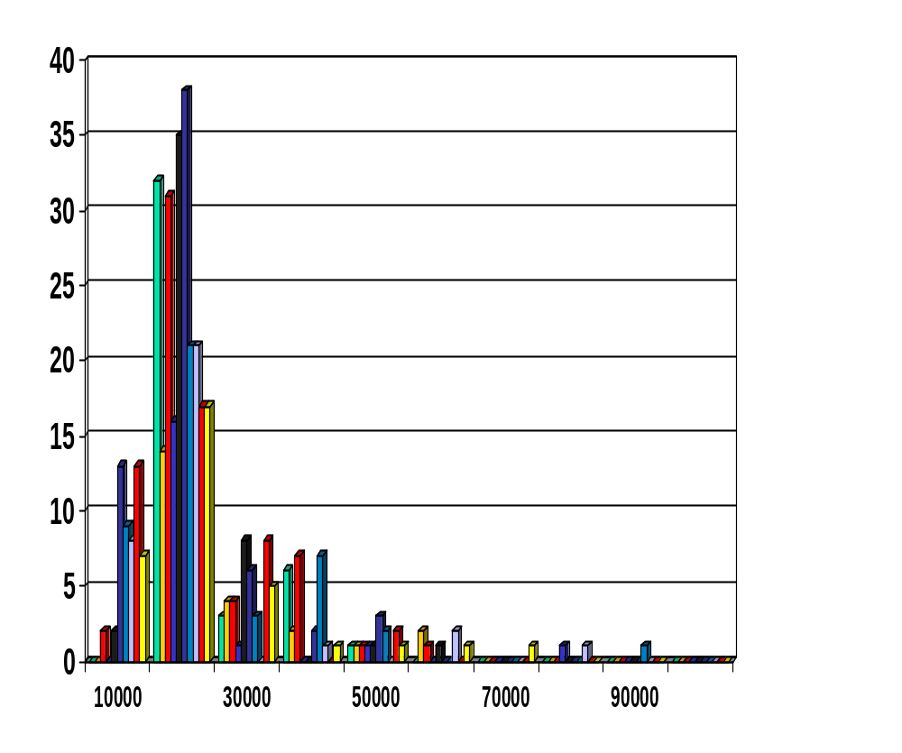
Data Reduction: Histograms
Divide data into buckets and store average (sum) for each bucket
Partitioning rules:
  Equal-width: equal bucket range
  Equal-frequency (or equal-depth)
  V-optimal: with the least histogram variance (weighted sum of the original values that each bucket represents)
  MaxDiff: set bucket boundary between each pair for pairs have the β–1 largest differences
Data Mining: Concepts and Techniques

Slide 65
Data Reduction Method: Clustering
Partition data set into clusters based on similarity, and store cluster representation (e.g., centroid and diameter) only
Can be very effective if data is clustered but not if data is “smeared”
Can have hierarchical clustering and be stored in multi-dimensional index tree structures
There are many choices of clustering definitions and clustering algorithms
Cluster analysis will be studied in depth in Chapter 7
Data Mining: Concepts and Techniques

Slide 66
Data Reduction Method: Sampling
Sampling: obtaining a small sample s to represent the whole data set N
Allow a mining algorithm to run in complexity that is potentially sub-linear to the size of the data
Key principle: Choose a representative subset of the data
  Simple random sampling may have very poor performance in the presence of skew
  Develop adaptive sampling methods, e.g., stratified sampling:
Note: Sampling may not reduce database I/Os (page at a time)
Data Mining: Concepts and Techniques

Slide 67
Types of Sampling
Simple random sampling
  There is an equal probability of selecting any particular item
Sampling without replacement
  Once an object is selected, it is removed from the population
Sampling with replacement
  A selected object is not removed from the population
Stratified sampling:
  Partition the data set, and draw samples from each partition (proportionally, i.e., approximately the same percentage of the data)
  Used in conjunction with skewed data
Data Mining: Concepts and Techniques

Slide 68
Sampling: With or without Replacement
SRSWOR
(simple random
sample without
replacement)
SRSWR
Raw Data
Data Mining: Concepts and Techniques

Slide 69
Sampling: Cluster or Stratified Sampling
Raw Data
Cluster/Stratified Sample
Data Mining: Concepts and Techniques

Slide 70
Data Reduction: Discretization
Three types of attributes:
  Nominal — values from an unordered set, e.g., color, profession
  Ordinal — values from an ordered set, e.g., military or academic rank
  Continuous — real numbers, e.g., integer or real numbers
Discretization:
  Divide the range of a continuous attribute into intervals
  Some classification algorithms only accept categorical attributes.
  Reduce data size by discretization
  Prepare for further analysis
Data Mining: Concepts and Techniques

Slide 71
Discretization and Concept Hierarchy
Discretization
  Reduce the number of values for a given continuous attribute by dividing the range of the attribute into intervals
  Interval labels can then be used to replace actual data values
  Supervised vs. unsupervised
  Split (top-down) vs. merge (bottom-up)
  Discretization can be performed recursively on an attribute
Concept hierarchy formation
  Recursively reduce the data by collecting and replacing low level concepts (such as numeric values for age) by higher level concepts (such as young, middle-aged, or senior)
Data Mining: Concepts and Techniques

Slide 72
Discretization and Concept Hierarchy Generation for Numeric Data
Typical methods: All the methods can be applied recursively
  Binning (covered above)
    Top-down split, unsupervised,
  Histogram analysis (covered above)
    Top-down split, unsupervised
  Clustering analysis (covered above)
    Either top-down split or bottom-up merge, unsupervised
  Entropy-based discretization: supervised, top-down split
  Interval merging by χ² Analysis: unsupervised, bottom-up merge
  Segmentation by natural partitioning: top-down split, unsupervised
Data Mining: Concepts and Techniques

Slide 73
Entropy-based Discretization
Using Entropy-based measure for attribute selection
  Ex. Decision tree construction
Generalize the idea for discretization numerical attributes
Data Mining: Concepts and Techniques

Slide 74
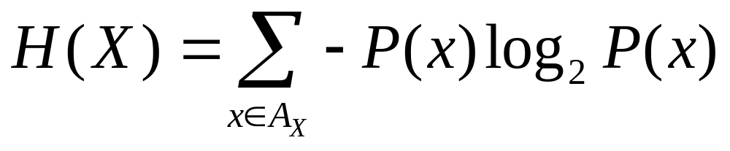
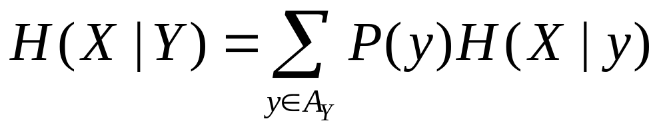
Definition of Entropy
Entropy
Example: Coin Flip
  A_{X} = {heads, tails}
  P(heads) = P(tails) = ½
  ½ log₂(½) = ½ * - 1
  H(X) = 1
What about a two-headed coin?
Conditional Entropy:
Data Mining: Concepts and Techniques

Slide 75
Entropy
Entropy measures the amount of information in a random variable; it’s the average length of the message needed to transmit an outcome of that variable using the optimal code
  Uncertainty, Surprise, Information
  “High Entropy” means X is from a uniform (boring) distribution
  “Low Entropy” means X is from a varied (peaks and valleys) distribution
Data Mining: Concepts and Techniques

Slide 76
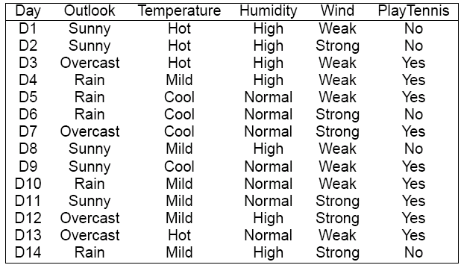
Playing Tennis
Data Mining: Concepts and Techniques

Slide 77
Choosing an Attribute
We want to make decisions based on one of the attributes
There are four attributes to choose from:
  Outlook
  Temperature
  Humidity
  Wind
Data Mining: Concepts and Techniques

Slide 78
Example:
What is Entropy of play?
-5/14*log2(5/14) – 9/14*log2(9/14)
= Entropy(5/14,9/14) = 0.9403
Now based on Outlook, divided the set into three subsets, compute the entropy for each subset
The expected conditional entropy is:
5/14 * Entropy(3/5,2/5) +
4/14 * Entropy(1,0) +
5/14 * Entropy(3/5,2/5) = 0.6935
Data Mining: Concepts and Techniques

Slide 79
Outlook Continued
The expected conditional entropy is:
5/14 * Entropy(3/5,2/5) +
4/14 * Entropy(1,0) +
5/14 * Entropy(3/5,2/5) = 0.6935
So IG(Outlook) = 0.9403 – 0.6935 = 0.2468
We seek an attribute that makes partitions as pure as possible
Data Mining: Concepts and Techniques

Slide 80
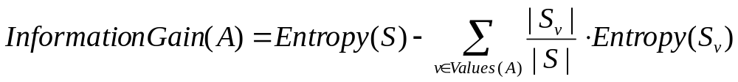
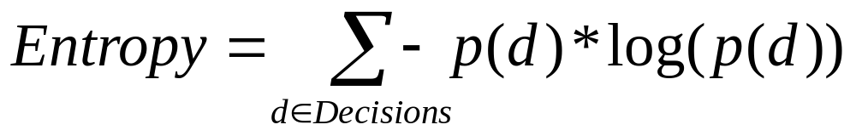
Information Gain in a Nutshell
typically yes/no
Data Mining: Concepts and Techniques

Slide 81
Temperature
Now let us look at the attribute Temperature
The expected conditional entropy is:
4/14 * Entropy(2/4,2/4) +
6/14 * Entropy(4/6,2/6) +
4/14 * Entropy(3/4,1/4) = 0.9111
So IG(Temperature) = 0.9403 – 0.9111 = 0.0292
Data Mining: Concepts and Techniques

Slide 82
Humidity
Now let us look at attribute Humidity
What is the expected conditional entropy?
7/14 * Entropy(4/7,3/7) +
7/14 * Entropy(6/7,1/7) = 0.7885
So IG(Humidity) = 0.9403 – 0.7885
= 0.1518
Data Mining: Concepts and Techniques

Slide 83
Wind
What is the information gain for wind?
Expected conditional entropy:
8/14 * Entropy(6/8,2/8) +
6/14 * Entropy(3/6,3/6) = 0.8922
IG(Wind) = 0.9403 – 0.8922 = 0.048
Data Mining: Concepts and Techniques

Slide 84
Information Gains
Outlook 0.2468
Temperature 0.0292
Humidity 0.1518
Wind 0.0481
We choose Outlook since it has the highest information gain
Data Mining: Concepts and Techniques

Slide 85
Now Generalize the idea for discretizing numerical values
What are the procedures?
  How to get intervals?
  Recursively binary split
  Binary splits
    Temperature < 71
    Temperature > 69
How to select position for binary split?
  Comparing to categorical attribute selection
When do stop?
Data Mining: Concepts and Techniques

Slide 86
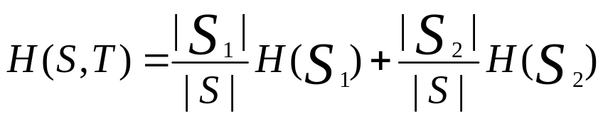
General Description Disc
Given a set of samples S, if S is partitioned into two intervals S1 and S2 using boundary T, the entropy after partitioning is
The boundary that minimizes the entropy function over all possible boundaries is selected as a binary discretization.
  Maximize the information gain
  We seek a discretization that makes subintervals as pure as possible
Data Mining: Concepts and Techniques

Slide 87
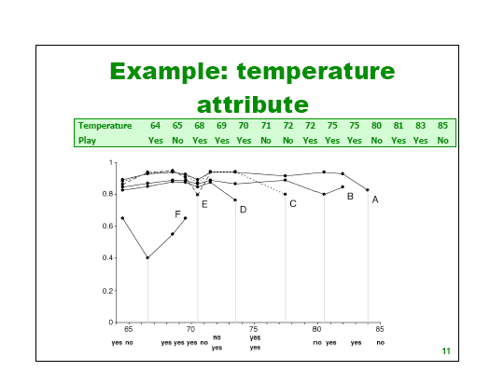
Data Mining: Concepts and Techniques

Slide 88
Entropy-based discretization
It is common to place numeric thresholds halfway between the values that delimit the boundaries of a concept
Fact
  cut point minimizing info never appears between two consequtive examples of the same class
  → we can reduce the # of candidate points
Data Mining: Concepts and Techniques

Slide 89
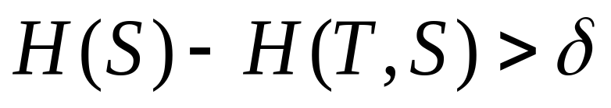
Procedure
Recursively split intervals
  apply attribute selection method to find the initial split
  repeat this process in both parts
The process is recursively applied to partitions obtained until some stopping criterion is met, e.g.,
Data Mining: Concepts and Techniques

Slide 90
64 65 68 69 70 71 72 75 80 81 83 85
Y N Y Y Y N N/Y Y/Y N Y Y N
F E D C B A
66.5 70.5 73.5 77.5 80.5 84
Data Mining: Concepts and Techniques

Slide 91
When to stop recursion?
Setting Threshold
Use MDL principle
  no split: encode example classes
  split
    ’model’ = splitting point takes log(N-1) bits to encode (N = # of instances)
    plus encode classes in both partitions
  optimal situation
    ’all < are yes’ & ’all > are no’
    each instance costs 1 bit without splitting and almost 0 bits with it
  formula for MDL-based gain threshold
    the devil is in the details
Data Mining: Concepts and Techniques

Slide 92
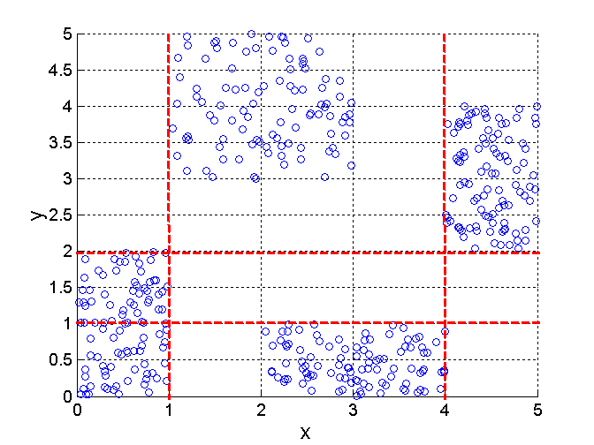
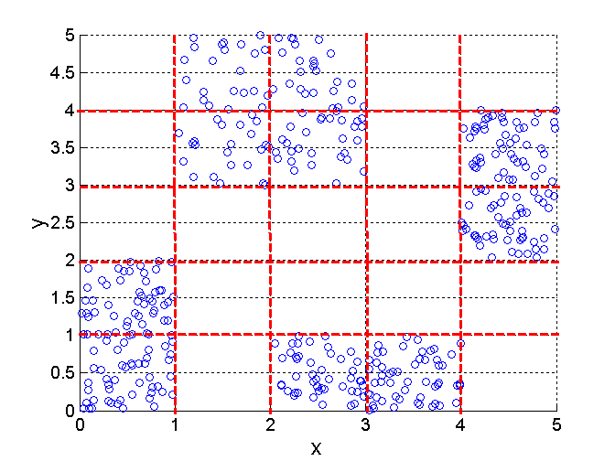
Discretization Using Class Labels
Entropy based approach
3 categories for both x and y
5 categories for both x and y
Data Mining: Concepts and Techniques

Slide 93
Discretization Using Class Labels
Entropy based approach
3 categories for both x and y
5 categories for both x and y
Data Mining: Concepts and Techniques

Slide 94
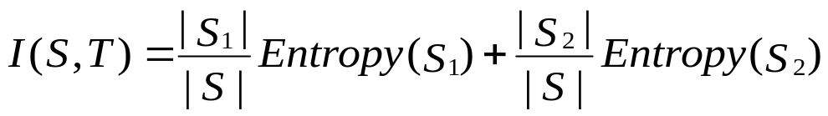
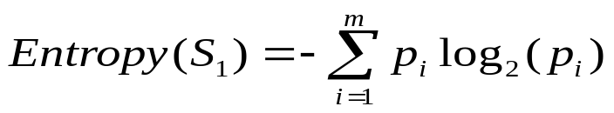
Entropy-Based Discretization
Given a set of samples S, if S is partitioned into two intervals S₁ and S₂ using boundary T, the information gain after partitioning is
Entropy is calculated based on class distribution of the samples in the set. Given m classes, the entropy of S₁ is
  where p_{i} is the probability of class i in S₁
The boundary that minimizes the entropy function over all possible boundaries is selected as a binary discretization
The process is recursively applied to partitions obtained until some stopping criterion is met
Such a boundary may reduce data size and improve classification accuracy
Data Mining: Concepts and Techniques

Slide 95
Interval Merge by χ² Analysis
Merging-based (bottom-up) vs. splitting-based methods
Merge: Find the best neighboring intervals and merge them to form larger intervals recursively
ChiMerge [Kerber AAAI 1992, See also Liu et al. DMKD 2002]
  Initially, each distinct value of a numerical attr. A is considered to be one interval
  χ² tests are performed for every pair of adjacent intervals
  Adjacent intervals with the least χ² values are merged together, since low χ² values for a pair indicate similar class distributions
  This merge process proceeds recursively until a predefined stopping criterion is met (such as significance level, max-interval, max inconsistency, etc.)
Data Mining: Concepts and Techniques

Slide 96
Segmentation by Natural Partitioning
A simply 3-4-5 rule can be used to segment numeric data into relatively uniform, “natural” intervals.
  If an interval covers 3, 6, 7 or 9 distinct values at the most significant digit, partition the range into 3 equi-width intervals
  If it covers 2, 4, or 8 distinct values at the most significant digit, partition the range into 4 intervals
  If it covers 1, 5, or 10 distinct values at the most significant digit, partition the range into 5 intervals
Data Mining: Concepts and Techniques

Slide 97
Chapter 2: Data Preprocessing
Why preprocess the data?
Data cleaning
Data integration and transformation
Data reduction
Discretization and concept hierarchy generation
Summary
Data Mining: Concepts and Techniques

Slide 98
Summary
Data preparation or preprocessing is a big issue for both data warehousing and data mining
Discriptive data summarization is need for quality data preprocessing
Data preparation includes
  Data cleaning and data integration
  Data reduction and feature selection
  Discretization
A lot a methods have been developed but data preprocessing still an active area of research
Data Mining: Concepts and Techniques

Slide 99
Feature Subset Selection Techniques
Brute-force approach:
  Try all possible feature subsets as input to data mining algorithm
Embedded approaches:
  Feature selection occurs naturally as part of the data mining algorithm
Filter approaches:
  Features are selected before data mining algorithm is run
Wrapper approaches:
  Use the data mining algorithm as a black box to find best subset of attributes
Data Mining: Concepts and Techniques

Slide 100
References
D. P. Ballou and G. K. Tayi. Enhancing data quality in data warehouse environments. Communications of ACM, 42:73-78, 1999
T. Dasu and T. Johnson. Exploratory Data Mining and Data Cleaning. John Wiley & Sons, 2003
T. Dasu, T. Johnson, S. Muthukrishnan, V. Shkapenyuk. Mining Database Structure; Or, How to Build a Data Quality Browser. SIGMOD’02.
H.V. Jagadish et al., Special Issue on Data Reduction Techniques. Bulletin of the Technical Committee on Data Engineering, 20(4), December 1997
D. Pyle. Data Preparation for Data Mining. Morgan Kaufmann, 1999
E. Rahm and H. H. Do. Data Cleaning: Problems and Current Approaches. IEEE Bulletin of the Technical Committee on Data Engineering. Vol.23, No.4
V. Raman and J. Hellerstein. Potters Wheel: An Interactive Framework for Data Cleaning and Transformation, VLDB’2001
T. Redman. Data Quality: Management and Technology. Bantam Books, 1992
Y. Wand and R. Wang. Anchoring data quality dimensions ontological foundations. Communications of ACM, 39:86-95, 1996
R. Wang, V. Storey, and C. Firth. A framework for analysis of data quality research. IEEE Trans. Knowledge and Data Engineering, 7:623-640, 1995
Data Mining: Concepts and Techniques

Slide 101
Backup Slides
Data Mining: Concepts and Techniques

Slide 102
PCA
Intuition: find the axis that shows the greatest variation, and project all points into this axis
f2
e1
e2
f1
Data Mining: Concepts and Techniques

Slide 103
PCA: The mathematical formulation
Find the eigenvectors of the covariance matrix
These define the new space
The eigenvalues sort them in “goodness”
order
f2
e1
e2
f1
Data Mining: Concepts and Techniques

Slide 104
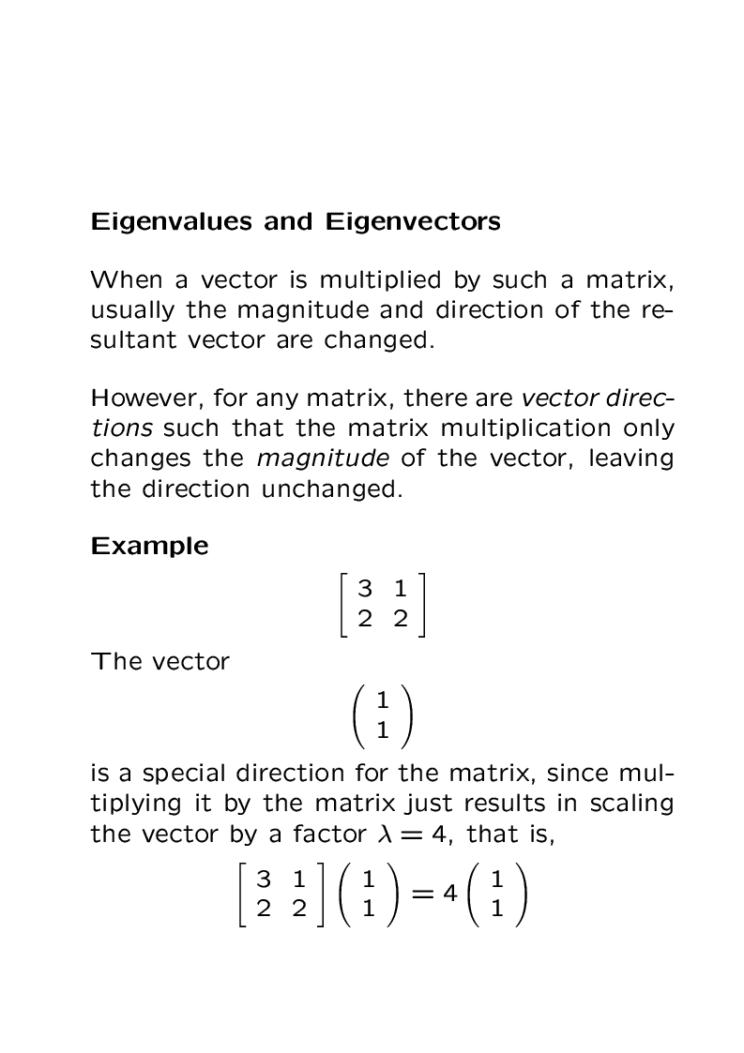
Data Mining: Concepts and Techniques

Slide 105
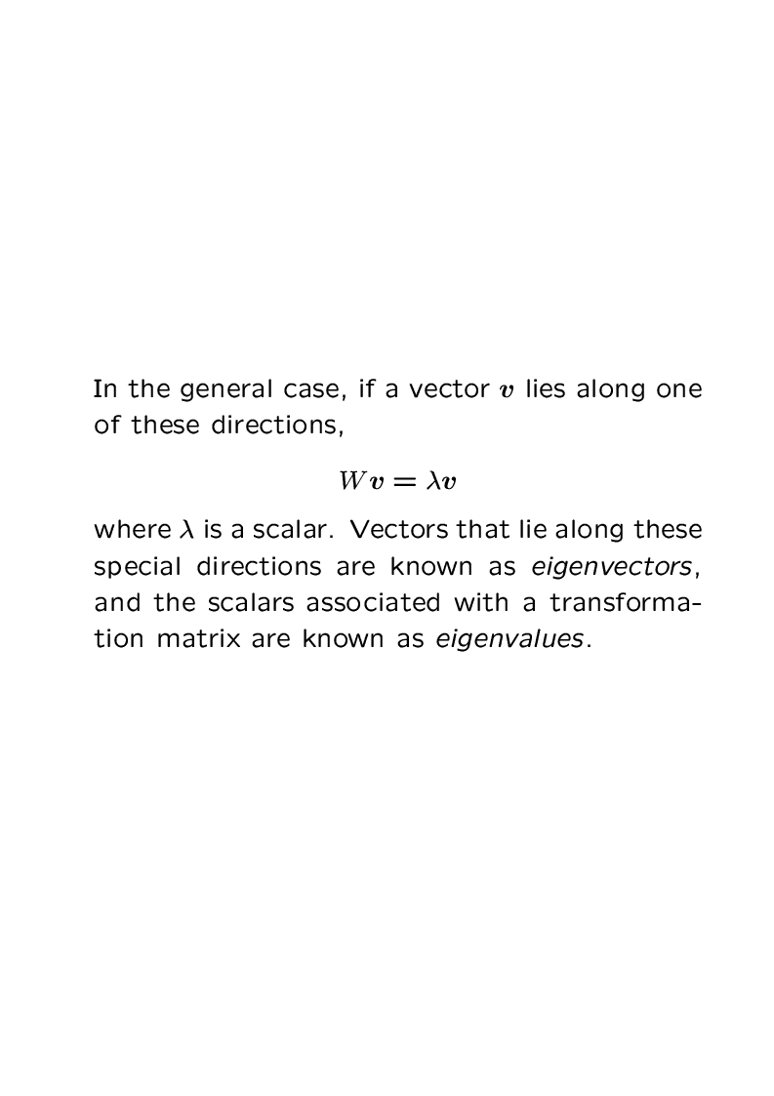
Data Mining: Concepts and Techniques

Slide 106
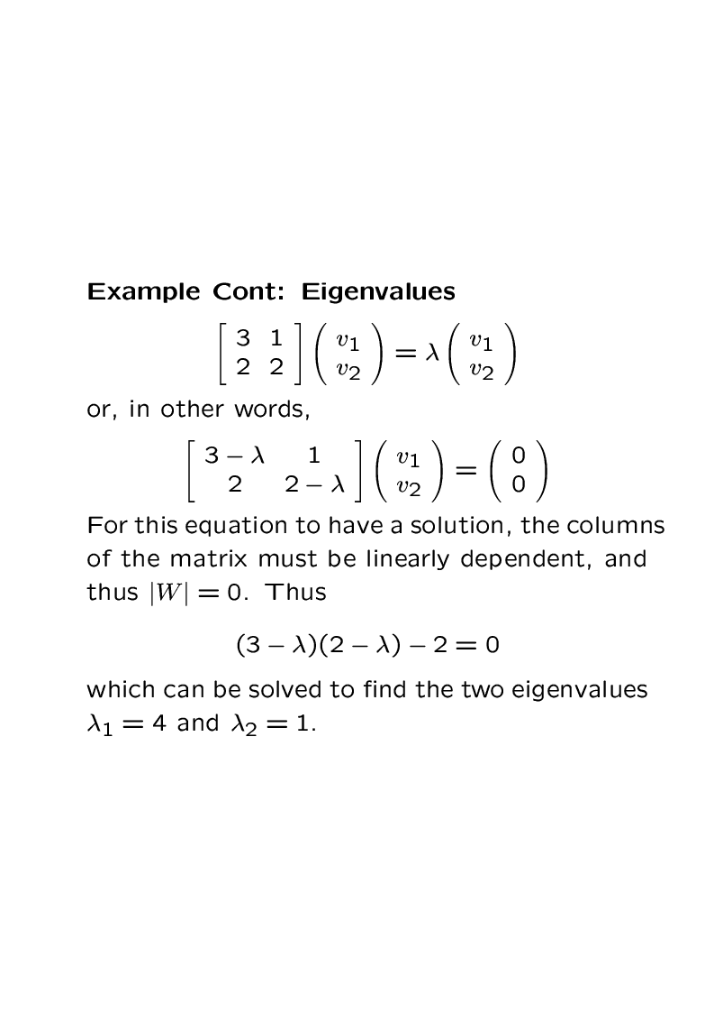
Data Mining: Concepts and Techniques

Slide 107
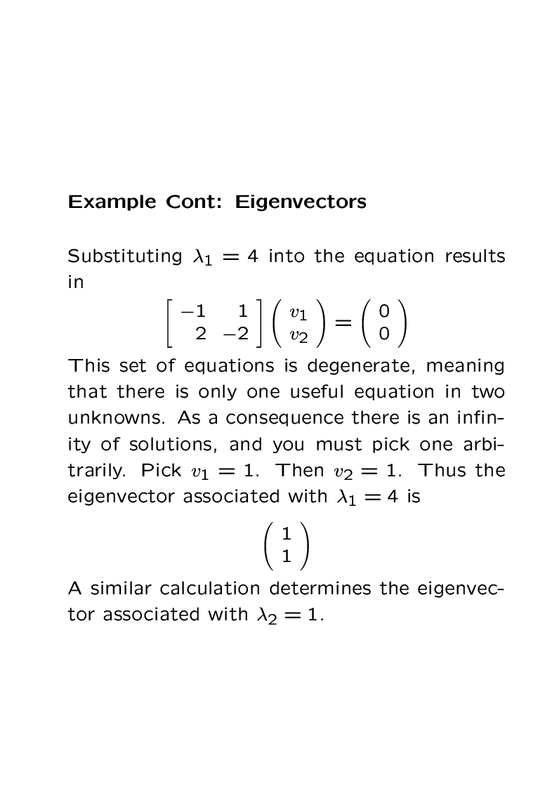
Data Mining: Concepts and Techniques

Slide 108
Principal Component Analysis
Given N data vectors from k-dimensions, find c ≤ k orthogonal vectors that can be best used to represent data
  The original data set is reduced to one consisting of N data vectors on c principal components (reduced dimensions)
Each data vector is a linear combination of the c principal component vectors
Data Mining: Concepts and Techniques

Slide 109
Principal components
1. principal component (PC1)
  the direction along which there is greatest variation
2. principal component (PC2)
  the direction with maximum variation left in data, orthogonal to the 1. PC
Data Mining: Concepts and Techniques

Slide 110
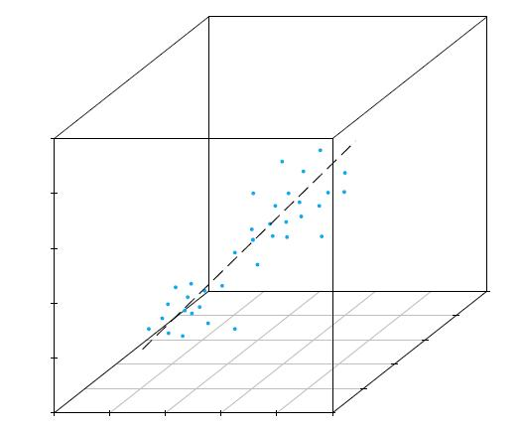
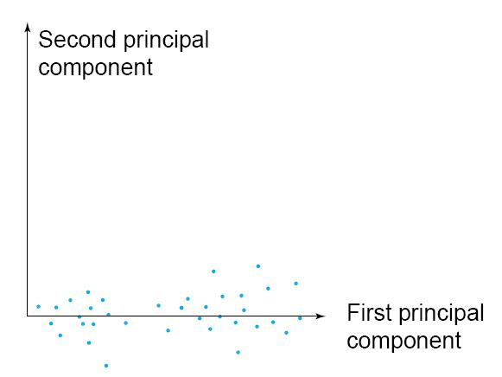
Principal components
Data Mining: Concepts and Techniques

Slide 111
Now’s let’s look at a detailed example
Data Mining: Concepts and Techniques

Slide 112
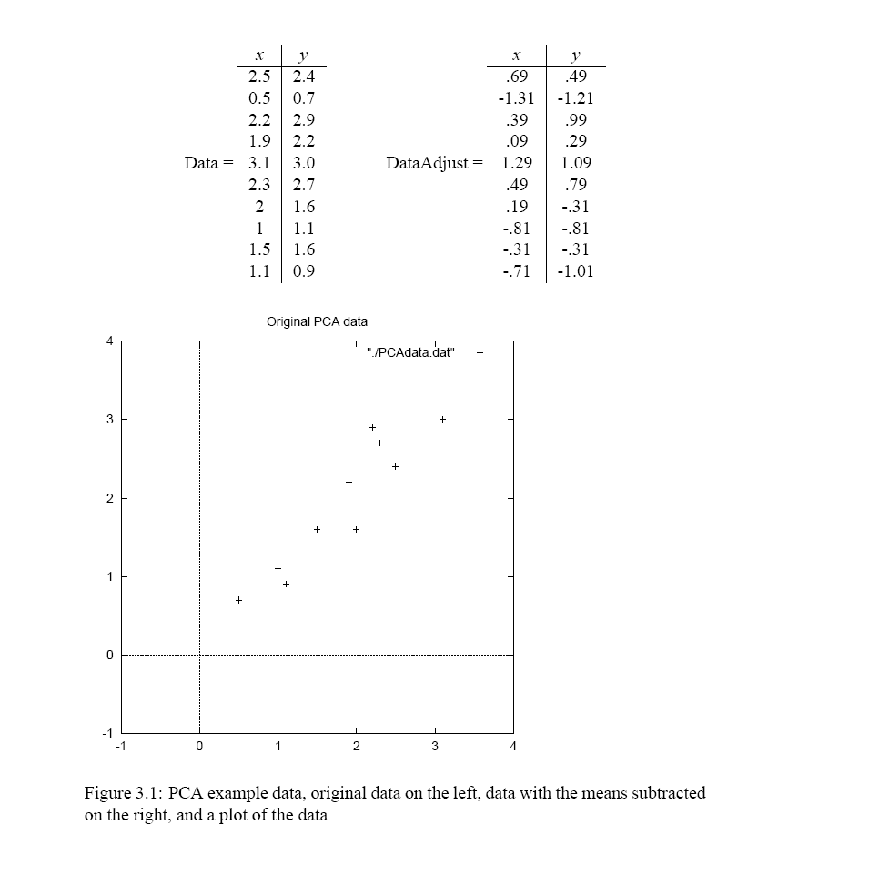
Data Mining: Concepts and Techniques

Slide 113
Compute the covariance matrix
Cov=(0.61656 0.61544;
0.61544 0.71656)
Computer the eigenvalues/eigenvectors
Of the covariance matrix
eigvalue1: 1.284
eigenvalue2: 0.04908
eigenvector1: -0.6778 -0.73517
eigenvector2: -0.73517 0.67787
Data Mining: Concepts and Techniques

Slide 114
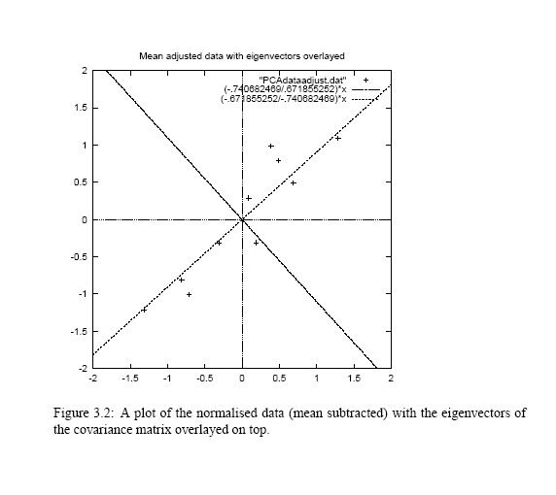
Data Mining: Concepts and Techniques

Slide 115
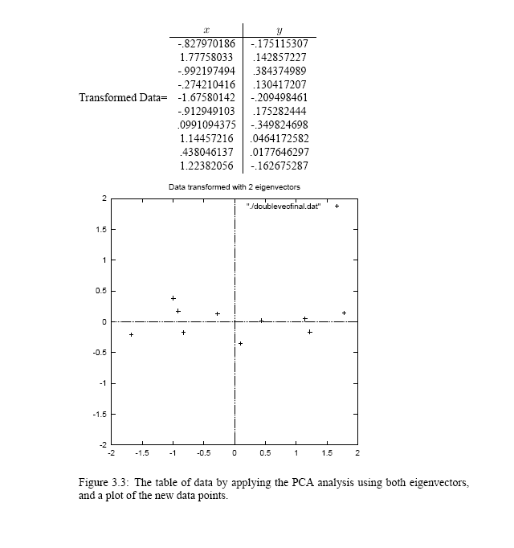
Data Mining: Concepts and Techniques

Slide 116
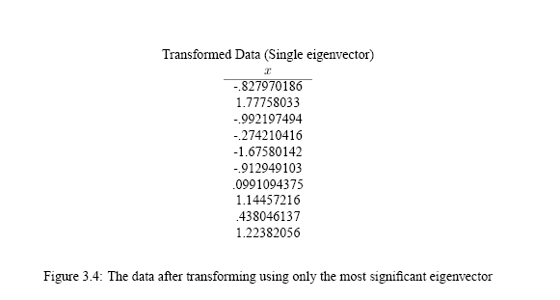
Using only a single eigenvector
Data Mining: Concepts and Techniques

Slide 117
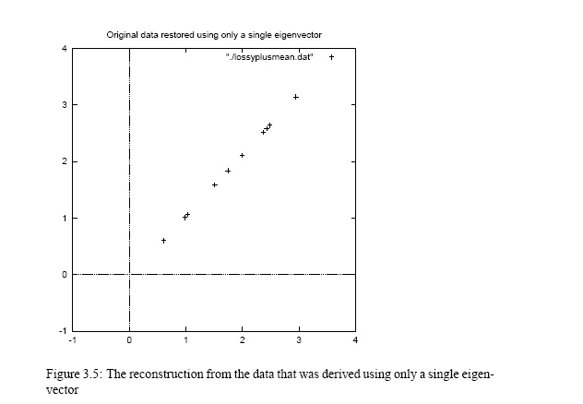
Data Mining: Concepts and Techniques

Slide 118
Data Mining: Concepts and Techniques

